Slide 1
Bigtable, Hive, and Pig
This work is licensed under a Creative Commons Attribution-Noncommercial-Share Alike 3.0 United States
See http://creativecommons.org/licenses/by-nc-sa/3.0/us/ for details

Slide 2
Bigtable

Slide 3
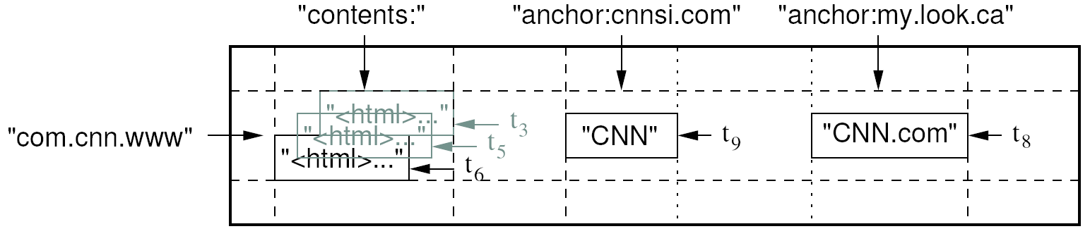
Data Model
A table in Bigtable is a sparse, distributed, persistent multidimensional sorted map
Map indexed by a row key, column key, and a timestamp
  (row:string, column:string, time:int64) → uninterpreted byte array
Supports lookups, inserts, deletes
  Single row transactions only
Image Source: Chang et al., OSDI 2006

Slide 4
Rows and Columns
Rows maintained in sorted lexicographic order
  Applications can exploit this property for efficient row scans
  Row ranges dynamically partitioned into tablets
Columns grouped into column families
  Column key = family:qualifier
  Column families provide locality hints
  Unbounded number of columns

Slide 5
Bigtable Building Blocks
GFS
Chubby
SSTable

Slide 6
SSTable
Basic building block of Bigtable
Persistent, ordered immutable map from keys to values
  Stored in GFS
Sequence of blocks on disk plus an index for block lookup
  Can be completely mapped into memory
Supported operations:
  Look up value associated with key
  Iterate key/value pairs within a key range
64K block
64K block
64K block
SSTable
Index
Source: Graphic from slides by Erik Paulson

Slide 7
Tablet
Dynamically partitioned range of rows
Built from multiple SSTables
Tablet
Start:aardvark
End:apple
64K block
64K block
64K block
SSTable
64K block
64K block
64K block
SSTable
Index
Index
Source: Graphic from slides by Erik Paulson

Slide 8
Architecture
Client library
Single master server
Tablet servers

Slide 9
Bigtable Master
Assigns tablets to tablet servers
Detects addition and expiration of tablet servers
Balances tablet server load. Tablets are distributed randomly on nodes of the cluster for load balancing.
Handles garbage collection
Handles schema changes

Slide 10
Bigtable Tablet Servers
Each tablet server manages a set of tablets
  Typically between ten to a thousand tablets
  Each 100-200 MB by default
Handles read and write requests to the tablets
Splits tablets that have grown too large

Slide 11
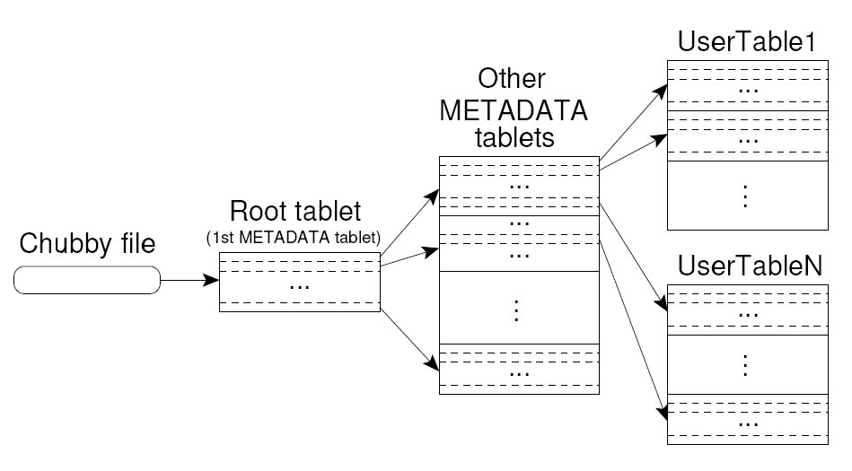
Tablet Location
Using a 3-level B+-tree
Upon discovery, clients cache tablet locations
Image Source: Chang et al., OSDI 2006

Slide 12
Tablet Assignment
Master keeps track of:
  Set of live tablet servers
  Assignment of tablets to tablet servers
  Unassigned tablets
Each tablet is assigned to one tablet server at a time
  Tablet server maintains an exclusive lock on a file in Chubby
  Master monitors tablet servers and handles assignment
Changes to tablet structure
  Table creation/deletion (master initiated)
  Tablet merging (master initiated)
  Tablet splitting (tablet server initiated)

Slide 13
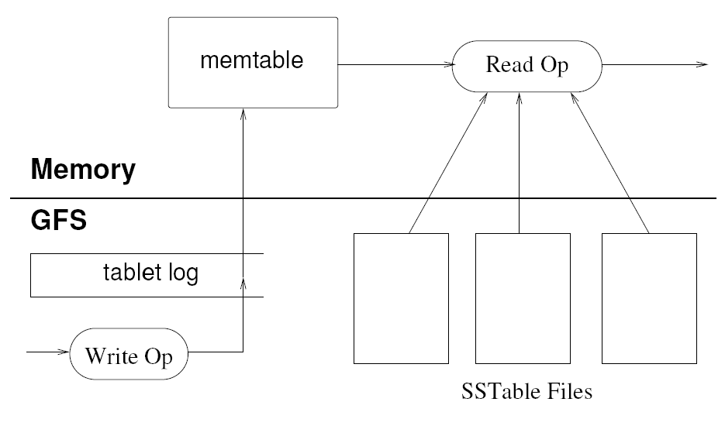
Tablet Serving
“Log Structured Merge Trees”
Image Source: Chang et al., OSDI 2006

Slide 14
Compactions
Minor compaction
  Converts the memtable into an SSTable
  Reduces memory usage and log traffic on restart
Merging compaction
  Reads the contents of a few SSTables and the memtable, and writes out a new SSTable
  Reduces number of SSTables
Major compaction
  Merging compaction that results in only one SSTable
  No deletion records, only live data

Slide 15
Lock server
Chubby
– Highly-available & persistent distributed lock service
– Five active replicas; one acts as master to serve requests
Chubby is used to:
– Ensure there is only one active master
– Store bootstrap location of BigTable data
– Discover tablet servers
– Store BigTable schema information
– Store access control lists
If Chubby dies for a long period of time… Bigtable dies too….
  But this almost never happens…

Slide 16
Optimizations
Log of tablets in the same server are merged in one log per tablet server (node)
Locality groups: separate SSTables are created for each locality group of column families that form the locality groups.
Use efficient and lightweight compression to reduce the size of SSTable blocks. Since data are organized by column(s) very good compression is achieved (similar values together)
Tablet servers use two levels of caching
Bloom filters are used to skip some SSTables and reduce read overhead.

Slide 17
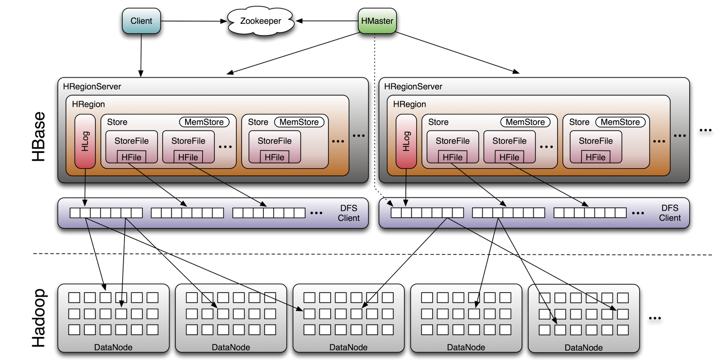
HBase
Open-source clone of Bigtable
Implementation hampered by lack of file append in HDFS
Image Source: http://www.larsgeorge.com/2009/10/hbase-architecture-101-storage.html

Slide 18
Hive and Pig

Slide 19
Need for High-Level Languages
Hadoop is great for large-data processing!
  But writing Java programs for everything is verbose and slow
  Not everyone wants to (or can) write Java code
Solution: develop higher-level data processing languages
  Hive: HQL is like SQL
  Pig: Pig Latin is a bit like Perl

Slide 20


Hive and Pig
Hive: data warehousing application in Hadoop
  Query language is HQL, variant of SQL
  Tables stored on HDFS as flat files
  Developed by Facebook, now open source
Pig: large-scale data processing system
  Scripts are written in Pig Latin, a dataflow language
  Developed by Yahoo!, now open source
  Roughly 1/3 of all Yahoo! internal jobs
Common idea:
  Provide higher-level language to facilitate large-data processing
  Higher-level language “compiles down” to Hadoop jobs

Slide 21
Hive: Background
Started at Facebook
Data was collected by nightly cron jobs into Oracle DB
“ETL” via hand-coded python
Grew from 10s of GBs (2006) to 1 TB/day new data (2007), now 10x that
Source: cc-licensed slide by Cloudera

Slide 22
Hive Components
Shell: allows interactive queries
Driver: session handles, fetch, execute
Compiler: parse, plan, optimize
Execution engine: DAG of stages (MR, HDFS, metadata)
Metastore: schema, location in HDFS, etc
Source: cc-licensed slide by Cloudera

Slide 23
Data Model
Tables
  Typed columns (int, float, string, boolean)
  Also, list: map (for JSON-like data)
Partitions
  For example, range-partition tables by date
Buckets
  Hash partitions within ranges (useful for sampling, join optimization)
Source: cc-licensed slide by Cloudera

Slide 24
Metastore
Database: namespace containing a set of tables
Holds table definitions (column types, physical layout)
Holds partitioning information
Can be stored in Derby, MySQL, and many other relational databases
Source: cc-licensed slide by Cloudera

Slide 25
Physical Layout
Warehouse directory in HDFS
  E.g., /user/hive/warehouse
Tables stored in subdirectories of warehouse
  Partitions form subdirectories of tables
Actual data stored in flat files
  Control char-delimited text, or SequenceFiles
  With custom SerDe, can use arbitrary format
Source: cc-licensed slide by Cloudera

Slide 26
Hive: Example
Hive looks similar to an SQL database
Relational join on two tables:
  Table of word counts from Shakespeare collection
  Table of word counts from Homer
SELECT s.word, s.freq, k.freq FROM shakespeare s
JOIN homer k ON (s.word = k.word) WHERE s.freq >= 1 AND k.freq >= 1
ORDER BY s.freq DESC LIMIT 10;
the 25848 62394
I 23031 8854
and 19671 38985
to 18038 13526
of 16700 34654
a 14170 8057
you 12702 2720
my 11297 4135
in 10797 12445
is 8882 6884
Source: Material drawn from Cloudera training VM

Slide 27
Hive: Behind the Scenes
SELECT s.word, s.freq, k.freq FROM shakespeare s
JOIN homer k ON (s.word = k.word) WHERE s.freq >= 1 AND k.freq >= 1
ORDER BY s.freq DESC LIMIT 10;
(Abstract Syntax Tree)
(TOK_QUERY (TOK_FROM (TOK_JOIN (TOK_TABREF shakespeare s) (TOK_TABREF homer k) (= (. (TOK_TABLE_OR_COL s) word) (. (TOK_TABLE_OR_COL k) word)))) (TOK_INSERT (TOK_DESTINATION (TOK_DIR TOK_TMP_FILE)) (TOK_SELECT (TOK_SELEXPR (. (TOK_TABLE_OR_COL s) word)) (TOK_SELEXPR (. (TOK_TABLE_OR_COL s) freq)) (TOK_SELEXPR (. (TOK_TABLE_OR_COL k) freq))) (TOK_WHERE (AND (>= (. (TOK_TABLE_OR_COL s) freq) 1) (>= (. (TOK_TABLE_OR_COL k) freq) 1))) (TOK_ORDERBY (TOK_TABSORTCOLNAMEDESC (. (TOK_TABLE_OR_COL s) freq))) (TOK_LIMIT 10)))
(one or more of MapReduce jobs)

Slide 28
Pig-Latin

Slide 29
Example Data Analysis Task
Find users who tend to visit “good” pages.
Visits
Pages
user | url | time
Amy | www.cnn.com | 8:00
Amy | www.crap.com | 8:05
Amy | www.myblog.com | 10:00
Amy | www.flickr.com | 10:05
Fred | cnn.com/index.htm | 12:00
url | pagerank
www.cnn.com | 0.9
www.flickr.com | 0.9
www.myblog.com | 0.7
www.crap.com | 0.2
. . .
. . .
Pig Slides adapted from Olston et al.

Slide 30
Conceptual Dataflow
Load
Visits(user, url, time)
Load
Pages(url, pagerank)
Canonicalize URLs
Join
url = url
Group by user
Compute Average Pagerank
Filter
avgPR > 0.5
Pig Slides adapted from Olston et al.

Slide 31
System-Level Dataflow
Visits
Pages
. . .
. . .
load
load
canonicalize
join by url
. . .
group by user
. . .
compute average pagerank
filter
the answer
Pig Slides adapted from Olston et al.

Slide 32
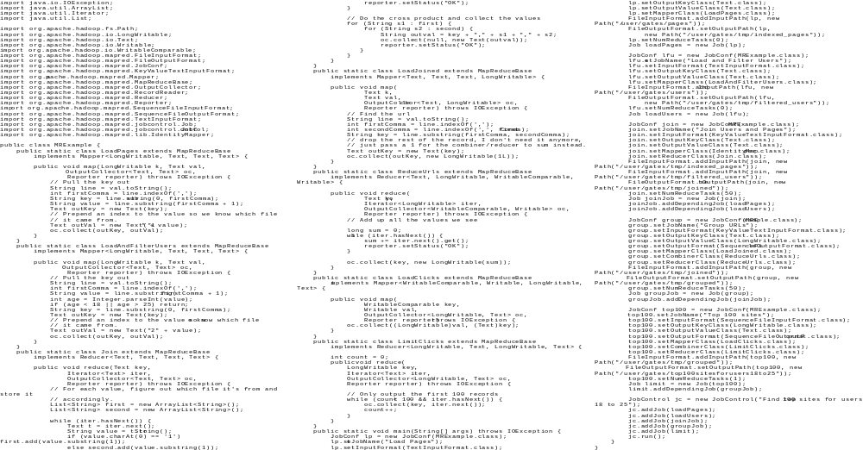
MapReduce Code
Pig Slides adapted from Olston et al.

Slide 33
Pig Latin Script
Visits = load ‘/data/visits’ as (user, url, time);
Visits = foreach Visits generate user, Canonicalize(url), time;
Pages = load ‘/data/pages’ as (url, pagerank);
VP = join Visits by url, Pages by url;
UserVisits = group VP by user;
UserPageranks = foreach UserVisits generate user, AVG(VP.pagerank) as avgpr;
GoodUsers = filter UserPageranks by avgpr > ‘0.5’;
store GoodUsers into '/data/good_users';
Pig Slides adapted from Olston et al.

Slide 34
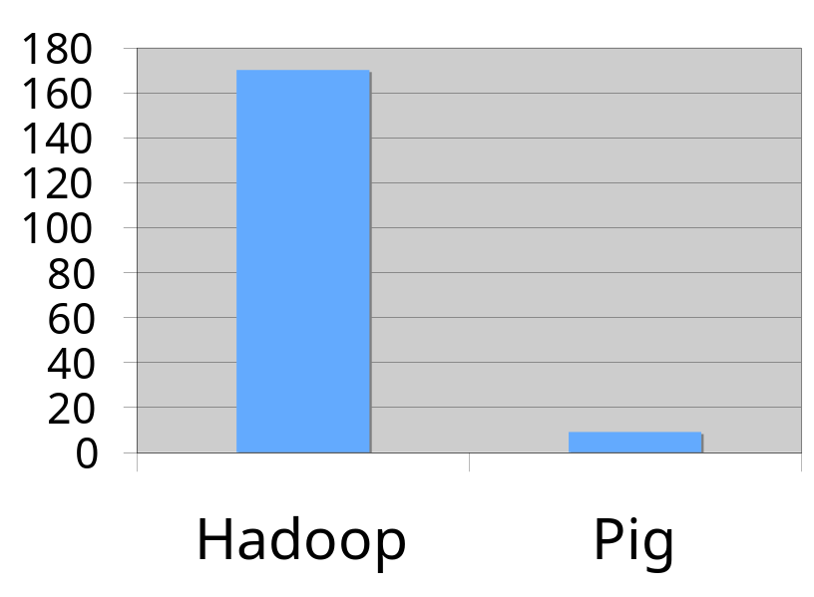
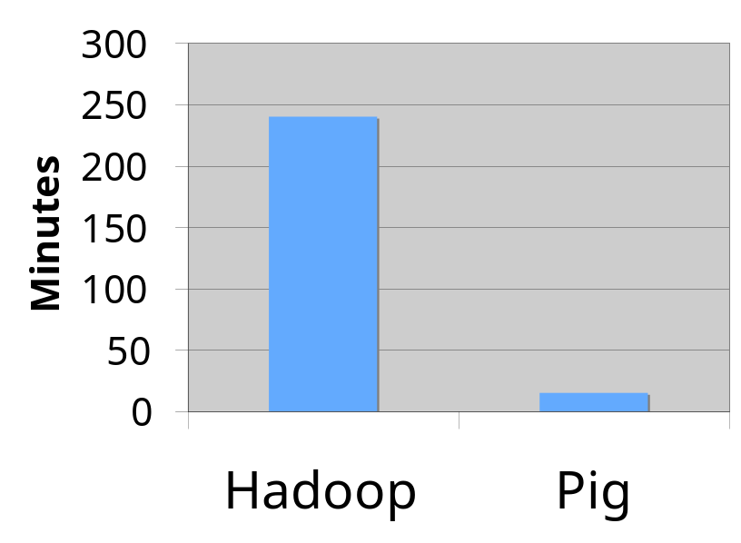
Java vs. Pig Latin
1/20 the lines of code
1/16 the development time
Performance on par with raw Hadoop!
Pig Slides adapted from Olston et al.

Slide 35
Pig takes care of…
Schema and type checking
Translating into efficient physical dataflow
  (i.e., sequence of one or more MapReduce jobs)
Exploiting data reduction opportunities
  (e.g., early partial aggregation via a combiner)
Executing the system-level dataflow
  (i.e., running the MapReduce jobs)
Tracking progress, errors, etc.

Slide 36
Another Pig Script:
Pig Script 2: Temporal Query Phrase Popularity
The Temporal Query Phrase Popularity script (script2-local.pig or script2-hadoop.pig) processes a search query log file from the Excite search engine and compares the occurrence of frequency of search phrases across two time periods separated by twelve hours.

Slide 37
Use the PigStorage function to load the excite log file (excite.log or excite-small.log) into the “raw” bag as an array of records with the fields user, time, and query.
raw = LOAD 'excite.log' USING PigStorage('\t') AS (user, time, query);
Call the NonURLDetector UDF to remove records if the query field is empty or a URL.
clean1 = FILTER raw BY org.apache.pig.tutorial.NonURLDetector(query);
Call the ToLower UDF to change the query field to lowercase.
clean2 = FOREACH clean1 GENERATE user, time, org.apache.pig.tutorial.ToLower(query) as query;
Because the log file only contains queries for a single day, we are only interested in the hour. The excite query log timestamp format is YYMMDDHHMMSS. Call the ExtractHour UDF to extract the hour from the time field.
houred = FOREACH clean2 GENERATE user, org.apache.pig.tutorial.ExtractHour(time) as hour, query;
Call the NGramGenerator UDF to compose the n-grams of the query.
ngramed1 = FOREACH houred GENERATE user, hour, flatten(org.apache.pig.tutorial.NGramGenerator(query)) as ngram;
Use the DISTINCT operator to get the unique n-grams for all records.
ngramed2 = DISTINCT ngramed1;
Use the GROUP operator to group the records by n-gram and hour.
hour_frequency1 = GROUP ngramed2 BY (ngram, hour);
Use the COUNT function to get the count (occurrences) of each n-gram.
hour_frequency2 = FOREACH hour_frequency1 GENERATE flatten($0), COUNT($1) as count;

Slide 38
Use the FOREACH-GENERATE operator to assign names to the fields.
hour_frequency3 = FOREACH hour_frequency2 GENERATE $0 as ngram, $1 as hour, $2 as count;
Use the FILTERoperator to get the n-grams for hour ‘00’
hour00 = FILTER hour_frequency2 BY hour eq '00';
Uses the FILTER operators to get the n-grams for hour ‘12’
hour12 = FILTER hour_frequency3 BY hour eq '12';
Use the JOIN operator to get the n-grams that appear in both hours.
same = JOIN hour00 BY $0, hour12 BY $0;
Use the FOREACH-GENERATE operator to record their frequency.
same1 = FOREACH same GENERATE hour_frequency2::hour00::group::ngram as ngram, $2 as count00, $5 as count12;
Use the PigStorage function to store the results. The output file contains a list of n-grams with the following fields: hour, count00, count12.
STORE same1 INTO '/tmp/tutorial-join-results' USING PigStorage();

